Slide 1
Oracle TP
One day training
Dragutin Jastrebic

Slide 2
Database model
Employees and departments, one department can have 0 or more employees, and each employee works in one and only
one departement, but there is one employee still not affected to any department. (The foreign key is on the opposite side of the arrow)
EMP
DEPT
Dragutin Jastrebic

Slide 3
Select statements
Oracle_test_script.sql
Select * from dept;
Select * from emp;
Set linesize 200
Dragutin Jastrebic

Slide 4
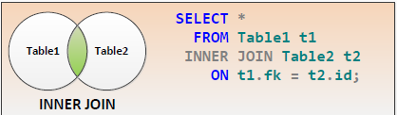
Inner join
Dragutin Jastrebic

Slide 5
Select statements (5 ways to do the inner join..)
Select * from emp, dept where emp.deptno=dept.deptno;
Select * from emp inner join dept on emp.deptno=dept.deptno;
Select * from emp natural join dept;
Select * from emp join dept on emp.deptno=dept.deptno;
Select * from emp e,dept d where e.deptno=d.deptno;
Dragutin Jastrebic

Slide 6
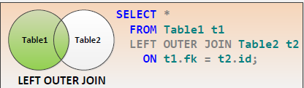
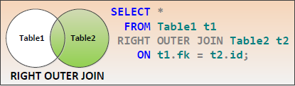
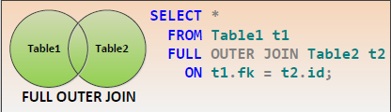
Outer join
Dragutin Jastrebic

Slide 7
Outer join, standard ansi syntax, that works starting with Oracle 9i
Select * from emp left outer join dept on emp.deptno=dept.deptno;
Select * from emp right outer join dept on emp.deptno=dept.deptno;
Select * from emp full outer join dept on emp.deptno=dept.deptno;
Dragutin Jastrebic

Slide 8
Outer join, Oracle syntax
Select * from emp,dept where emp.deptno=dept.deptno(+);
Select * from emp,dept where emp.deptno(+)=dept.deptno;
Dragutin Jastrebic

Slide 9
Full Outer join, Oracle syntax
Select * from emp,dept where emp.deptno=dept.deptno(+)
Union all
Select * from emp,dept where emp.deptno(+)=dept.deptno;
Dragutin Jastrebic

Slide 10
Grouping functions
select max(sal),min(sal),avg(sal),count(*),count(ename),count(comm),stddev(sal),
sum(sal)
from emp;
Select sum(sal),deptno from
emp
group by deptno;
Select sum(sal),job from emp
group by job;
Select sum(sal),job,deptno from emp
group by job,deptno;
Dragutin Jastrebic

Slide 11
Grouping functions
select d.deptno, d.dname, max(sal)
from emp e , dept d
where e.deptno = d.deptno
group by d.deptno,d.dname;
Dragutin Jastrebic

Slide 12
More about grouping functions (rollup, cube)
Select sum(sal),deptno
from emp
group by rollup(deptno);
Select sum(sal),deptno,job
from emp
group by cube(deptno,job);
Dragutin Jastrebic

Slide 13
Order by clause
Select * from emp order by sal;
… order by [field] asc/desc nulls first/last
Select * from emp order by empno;
Select * from emp order by empno,ename;
Select * from emp order by 1,2;
Select * from emp order by sal desc;
Select * from emp order by comm;
Select * from emp order by comm nulls first;
Select * from emp order by comm nuls last;
Select * from emp order by comm asc nulls first;
Select * from emp order by comm desc nulls first;
Select * from emp order by comm asc nulls last;
Select * from emp order by comm desc nulls last;
Dragutin Jastrebic

Slide 14
Other functions
Select upper(ename) from emp;
Select lower(ename) from emp;
Select initcap(ename) from emp;
Select dump(ename) from emp;
Select length(ename) from emp;
Select substr(ename,1,5) from emp;
Dragutin Jastrebic

Slide 15
Other functions
Select rpad(ename,10,’*’) from emp;
Select lpad(ename,10,’*’) from emp;
Dragutin Jastrebic

Slide 16
Sqlplus formatting commands)
Set feedback on|off
Set heading on|off
Set pagesize <N>
Set linesize <N>
Dragutin Jastrebic

Slide 17
TODO list
A ) Find all employees and their department name that earn more than 1000 and if there are employees without department, display them as well, and display all from biggest to lowest salary
and display a header for every 4 employees
B) Find all employees and their department name that earn more than 10 for the commission and if there are empty departments, display them as well, and display all from biggest to lowest comm with nulls at the end of the display, and display a header for every 5 employees
C) Display all the subtotals at the job level and the department level for all employees that have a commission
Dragutin Jastrebic

Slide 18
TODO list
A) Trouver tous les employés (et leur nom de département) qui gagnent plus de 1000 dollars et s‘il y a des employés sans département, les afficher aussi, et trier du plus grand au plus bas salaire et afficher une entête toutes les 4 lignes.
B) Trouver tous les employés ( et le nom de leur département ), qui gagnent plus de 10 dollars au niveau de leur prime , et si il y a des départements vides, les afficher aussi, et afficher les salariés sans prime à la fin de l'affichage, et afficher une en-tête toutes les 4 lignes
C) Afficher tous les sous-totaux au niveau du job et du département pour tous les employés qui ont une commission
Dragutin Jastrebic

Slide 19
More about grouping functions (which one is better of the 2 statements?)
select d.deptno, d.dname, max(sal)
from emp e , dept d
where e.deptno = d.deptno
and deptno> 10
group by d.deptno,d.dname;
select d.deptno, d.dname, max(sal)
from emp e , dept d
where e.deptno = d.deptno
group by d.deptno,d.dname
Having d. deptno=10;
Dragutin Jastrebic

Slide 20
Subqueries (subquery in the where clause…)
Select * from emp where deptno in (select deptno from dept where dname=‘RESEARCH’);
Dragutin Jastrebic

Slide 21
Subqueries (subquery in the where clause, existential subqueries)
Select * from emp where exists (select 1 from dept where dept.Deptno=emp.deptno);
Select * from emp where not exists (select 1 from dept where dept.Deptno=emp.deptno);
Select * from emp where deptno in (select deptno from dept);
Select * from emp where deptno not in (select deptno from dept);
Dragutin Jastrebic

Slide 22
Union, Intersect, Minus
Select * from emp where sal > 1000
union
Select * from emp where sal <500;
select deptno from emp
intersect
select deptno from dept;
select deptno from dept
minus
select deptno from emp;
Dragutin Jastrebic

Slide 23
Subqueries (subquery in the where clause,more exemples)
Select * from emp where sal > (select min(sal) from emp);
Select * from emp where sal > any (select sal from emp);
Select * from emp where sal < (select max(sal) from emp);
Select * from emp where sal < all (select sal from emp where deptno=10) and deptno=20;
Dragutin Jastrebic

Slide 24
Problems with group by
Select ename,sal,sum(sal), deptno from emp group by deptno;
=>ORA-00979: not a GROUP BY expression
Select ename,sal,sum(sal), deptno from emp group by deptno,ename,sal;
=> won’t give the wanted result!!!
Dragutin Jastrebic

Slide 25
Oracle analytics, powerfull solution
Select ename,sal,deptno,sum(sal) over (partition by deptno) ssal from emp;
Try the same with min,max,avg,count,stddev
Dragutin Jastrebic

Slide 26
Running summary
Select ename,sal,sum(sal) over(order by sal) running_sal from emp;
Select ename,sal,deptno,sum(sal) over(partition by deptno order by sal) running_sal from emp;
Select ename,sal,sum(sal) over(order by sal range unbounded preceding) from emp;
Select ename,sal,sum(sal) over(partition by order by sal range unbounded preceding) from emp;
Dragutin Jastrebic

Slide 27
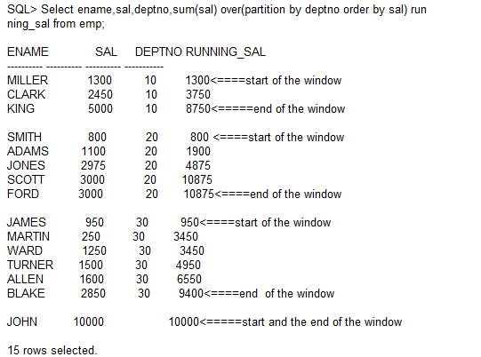
The window concept of Oracle analytics
Dragutin Jastrebic

Slide 28
Oracle analytics:rank(),dense_rank(),row_number
Select ename,sal,deptno,rank() over (order by sal) rrank,dense_rank() over (order by sal) drank, row_number() over (order by sal) rn from emp;
Select ename,sal,deptno,rank() over (partition by deptno order by sal) rrank,dense_rank() over (parttion by deptno order by sal) drank, row_number() over (partition by deptno order by sal) rn from emp;
Dragutin Jastrebic

Slide 29
Oracle analytics:lead(),lag()
Select ename,sal,deptno,lead(sal) over (order by sal) next_sal,lag(sal) over (order by sal) prev_sal from emp;
Select ename,sal,deptno,lead(sal,2) over (order by sal) next_sal,lag(sal,2) over (order by sal) prev_sal from emp;
Dragutin Jastrebic

Slide 30
Before analytics, we would write a PL/SQL for lead and lag
declare
salary number;
prev_salary number;
prev_prev_salary number;
next_salary number;
cnt number;
cursor c1 is select empno,ename,sal from emp order by deptno;
begin
cnt:=0;
for x in c1 loop
cnt:=cnt+1;
if cnt=1 then
prev_salary:=x.sal;
elsif cnt=2 then
salary:=x.sal;
elsif cnt=3 then
next_salary:=x.sal;
dbms_output.put_line('empno ename prev_sal sal next_sal');
dbms_output.put_line(x.empno||','||x.ename||','||prev_salary||','||salary||','||next_salary);
cnt:=0;
end if;
end loop;
end;
/
Dragutin Jastrebic

Slide 31
Oracle analytics: range and rows
(use live SQL, won’t work with Oracle express edition)
Select ename,deptno,hiredate,count(*) over (order by hiredate range 100 preceding) cnt_range, ename,count(*) over (order by hiredate rows 2 preceding) cnt_rows from emp;
Select ename,deptno,hiredate,count(*) over (partition by deptno order by hiredate range 100 preceding) cnt_range, ename,count(*) over (partition by deptno order by hiredate rows 2 preceding) cnt_rows from emp;
Select ename,deptno,hiredate,first_value(ename) over (partition by deptno order by hiredate rows 2 preceding),last_value(ename) over (partition by deptno order by hiredate rows 2 preceding) from emp;
Dragutin Jastrebic

Slide 32
Subquery in the select clause(scalar subquery)
SQL> select ename,sal,(select avg(sal) from emp where deptno=e.deptno group by deptno) avg_sal from emp e;
Dragutin Jastrebic

Slide 33
Subquery in the from clause
TOP N query:
Select * from (select deptno,ename,sal, dense_rank() over (partition by deptno order by sal desc) dr from emp)
where dr<=3
order by deptno,sal desc;
Dragutin Jastrebic

Slide 34
Sqlplus formatting commands
Select deptno,ename,sal from emp;
Compute sum of sal on report
Break on report
Compute sum of sal on deptno
Break on deptno
ttitle ‘EMP REPORT’
btitle ‘END REPORT’
Dragutin Jastrebic

Slide 35
MongoDB
https://www.mongodb.com/download-center#enterprise
Couple of self-explanatory screens to install
Mkdir c:\data\db
cd c:\...\mongodb\bin\
Mongod.ex to start the database
Then go again cd c:\...\mongodb\bin\ and start mongo.exe as a client shell
Dragutin Jastrebic

Slide 36
MongoDB (2)
Use test
db.emp.insert({empno:1,ename: “Bob”, sal: 100000})
db.emp.find()
db.emp.insert({empno:1,ename: “John”, sal: 9000, comm:100})
db.emp.insert({empno:1,ename: “Tom”, sal: 9000, remark:”half time”})
Dragutin Jastrebic

Slide 37
MongoDB (3)
db.emp.find({“sal”: {$gte:100000}})
db.emp.insert({empno:2,ename: “Eric”, sal: 5000,dname: “DALLAS”})
db.emp.find({“dname”: “DALLAS”})
Dragutin Jastrebic

